Slide 1
FEASIBILITY ANALYSIS
-RU HUNGRY!-
SYSTEM ANALYSIS AND DESIGN LAB
PROJECT
RU HUNGRY

Slide 2
Our Team
Kazi Sidratul Muntaha (011 182 0004)
Md. Zunayed Rahman (011 182 006)
Rashedur Rahman (011 182 075)
Md Sunmon Hossain Siam (011 181 035)
S.M. Ifran Nizum (011 181 165)
Aminul Islam (011 181 043)
RU HUNGRY!

Slide 3
SURVEY ATTENDEE STATISTICS
Total Participants: 26
Occupation:
76.9%
19.2%
3.8%
Student
Others
Businessman
RU HUNGRY!

Slide 4
SURVEY ATTENDEE STATISTICS
Gender
Age
Male
Female
15-20 Y OLD
30+ Y OLD
73.1%
26.9%
11.5%
7.7%
0%
80.8%
Prefer Not To say
20-30 Y OLD
RU HUNGRY!

Slide 5
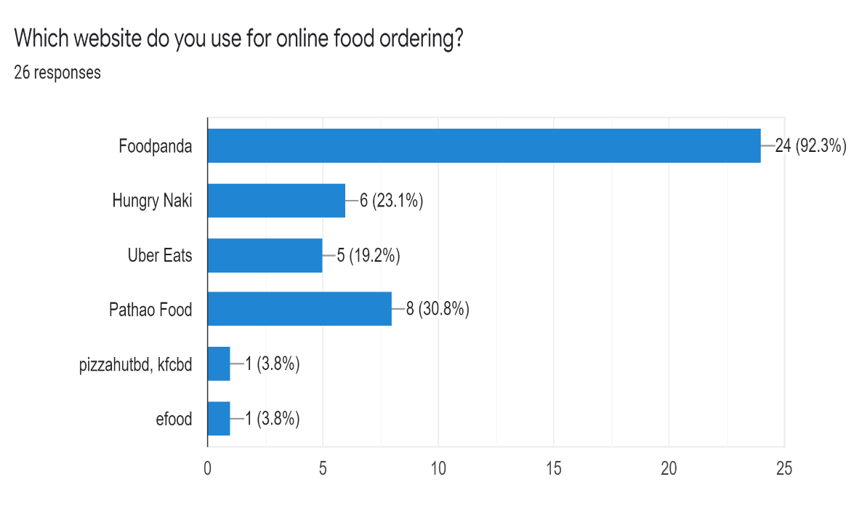
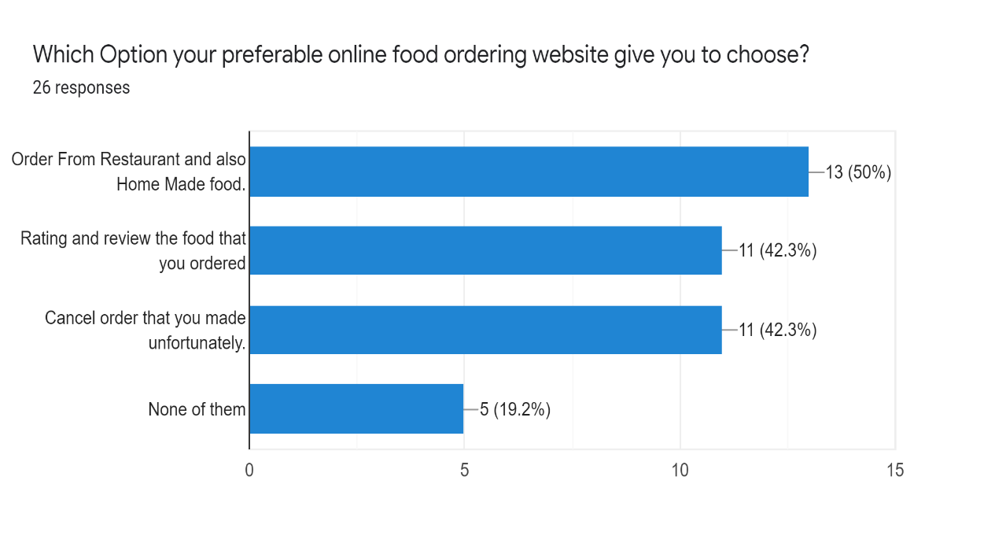
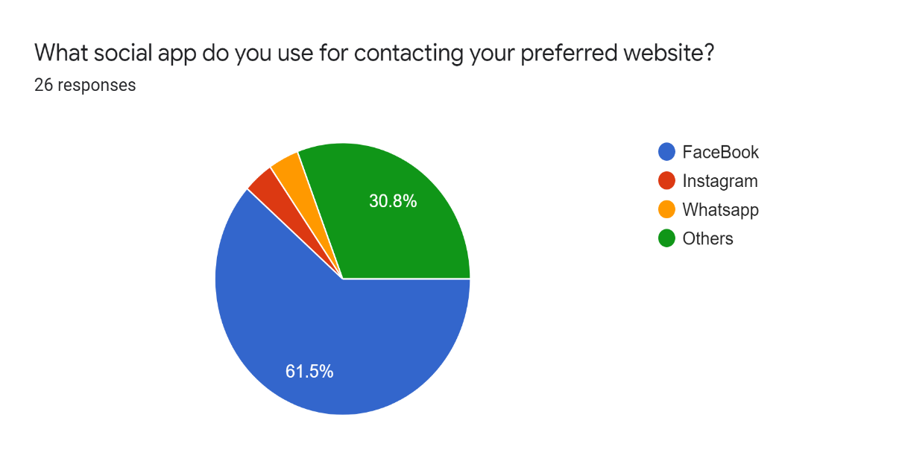
FeedBack
FeedBack
RU HUNGRY!

Slide 6
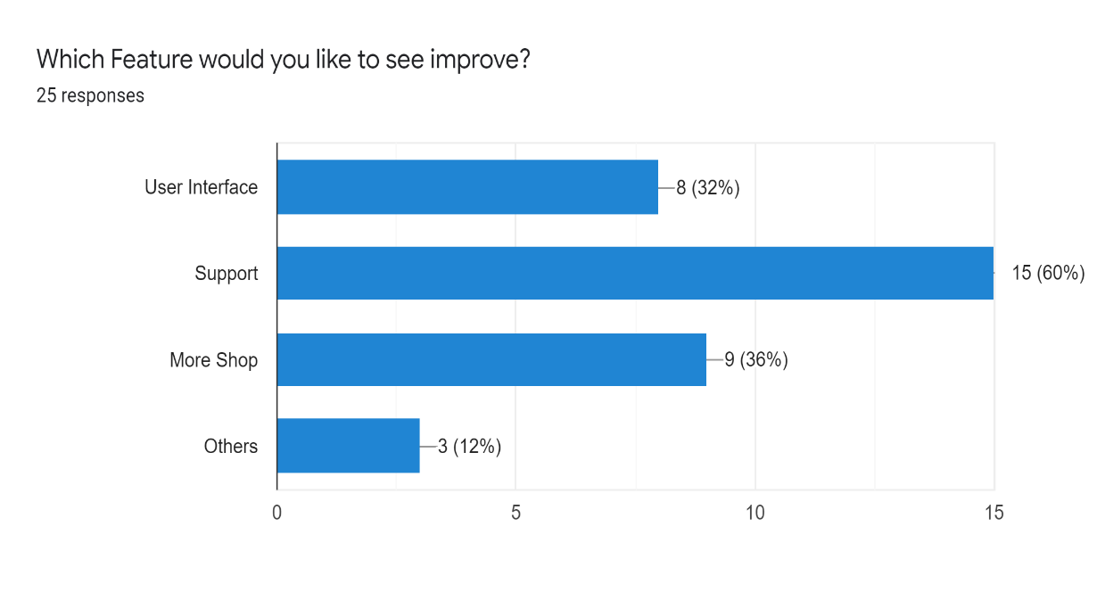
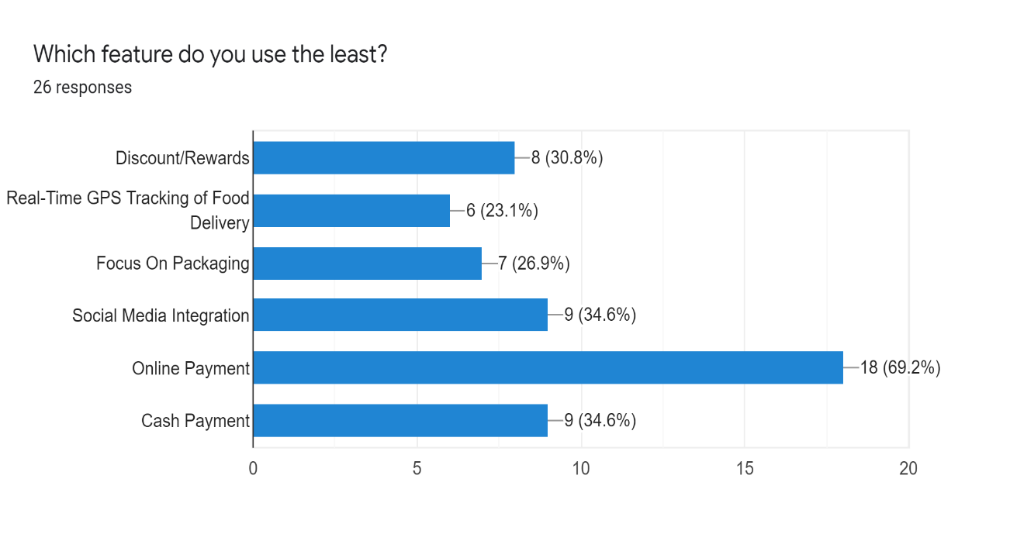
FeedBack
RU HUNGRY!

Slide 7
FeedBack
Response Questions | EXTREMELY NEEDED | PERFECT | OKAY | OF COURSE | NOT THAT USEFUL
IF YOU CAN ORDER FROM BOTH RESTAURANT AND HOMEMADE FOOD FROM ONE PLATRFORM, THEN WHAT DO YOU THINK ABOUT IT? | 50% | 38.5% | 11.5% |  | 0%
IF YOU CAN BOTH RATE AND REVIEW THE SPECIFIC FOOD THAT YOU HAVE ORDERED. DO YOU THINK THIS FEATURE WILL BE HELPFUL? |  |  |  | 100% | 0%
IF YOU CAN SEE THE RATING AND THE REVIEW FOR EVERY FOOD FROM EVERY RESTAURANT THEN WOULD IT BE MORE HELPFUL FOR YOU TO MAKE DECISION? |  |  |  | 100% | 0%
IF YOU UNFORTUNATELY PLACED AN ORDER, YOU CAN ALSO CANCEL THE ORDER WITHIN A FEW SECONDS. THEN WHAT DO YOU THINK ABOUT THIS? | 73.1% | 26.9% |  |  | 0%
Green = Maximum Audience Red= Least Audience Gray= Option Not Available for that question
*PowerPoint SmartArt graphic

Slide 8
Features:
Login / Signup
Admin Panel
User Can Choose
Review and Rating
Order History
Cancel Order
Cart
RU HUNGRY

Slide 9
S.W.O.T Analysis
STRENGTH
WEAKNESS
S
W
Free
Have Unique Features
Grab All types of Customers
Limited Features
Lack Of Financial Backup
O
T
OPPORTUNITYY
THREAT
Better Rank
Improve User Experience
Popularity Of other similar websites
Security issue
RU HUNGRY

Slide 10
THANK YOU
RU HUNGRY

